Slide 1
GIT 101
An introduction to git source control system

Slide 2
Origins
Created by Finnish-American Software Engineer, Linus Torvalds (creator of Linux) in 2005 after BitKeeper revoked it’s free-of-charge status.
Linux was using BitKeeper for it’s kernal source control.
Torvalds and the Linux community decided to develop their own tool based on the lessons they learned while using BitKeeper
Time magazine, alone has recognized Torvalds multiple times:
In 2000, he was 17th in their Time 100: The Most Important People of the Century poll.
In 2004, he was named one of the most influential people in the world by Time magazine.
In 2006, the magazine's Europe edition named him one of the revolutionary heroes of the past 60 years.
Source: https://en.wikipedia.org/wiki/Linus_Torvalds

Slide 3
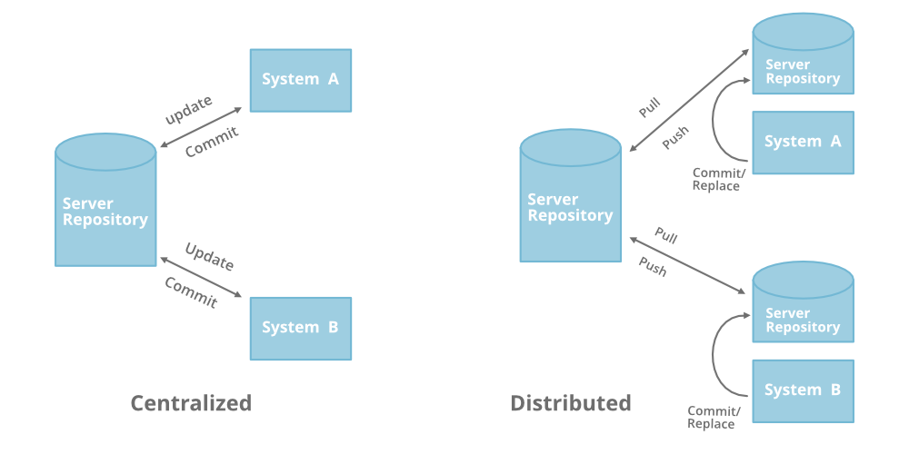
Centralized vs. distributed source control
TFS is a centralized source control system, while Git is distributed, which essentially means the entire repo is cloned to each developer’s machine.
With Git, each developer can ‘commit’ changes to their local machines without ever changing any code on the server.
With TFS, repos are stored on a central server and develops ‘check-out’ a working copy

Slide 4
CI/CD with Git
Continuous integration is a coding philosophy and set of practices that drive development teams to implement small changes and check in code to version control repositories frequently. Because most modern applications require developing code in different platforms and tools, the team needs a mechanism to integrate and validate its changes.
Continuous delivery picks up where continuous integration ends. CD automates the delivery of applications to selected infrastructure environments. Most teams work with multiple environments other than the production, such as development and testing environments, and CD ensures there is an automated way to push code changes to them.
Source:
https://www.infoworld.com/article/3271126/what-is-cicd-continuous-integration-and-continuous-delivery-explained.html

Slide 5
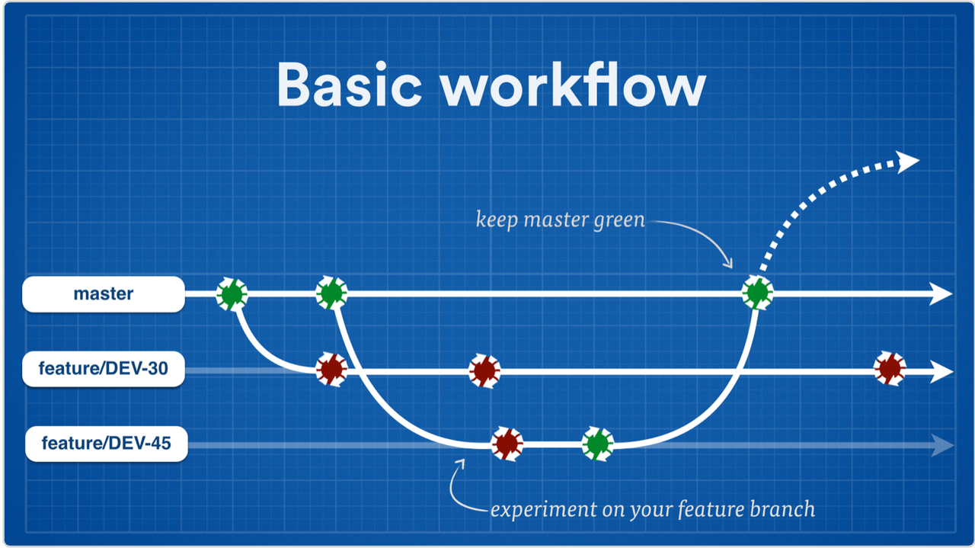
CI/CD with Git
Continuous Integration/Continuous Delivery

Slide 6
The basics of git
clone
fetch
add (stage)
commit
push
pull
branch
merge

Slide 7
Let’s go!
Everybody go to https://github.com/ and sign up
Go to my repo for this training session https://github.com/BenJokela/GitTraining and clone to your machine

Slide 8
Valuable links
https://git-scm.com/

